Slide 1
Arrays

Slide 2
An array is a data structure that contains a group of elements. Typically these elements are all of the same data type, such as an integer or string.
Arrays are commonly used in computer programs to organize data so that a related set of values can be easily sorted or searched.

Slide 3
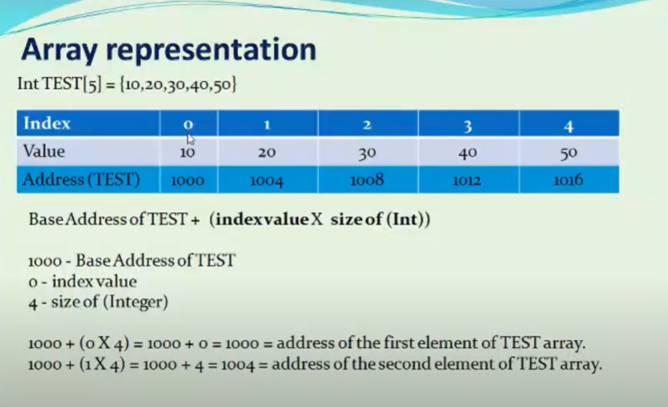

Slide 4
Single-Dimensional Arrays
Generic declaration:
    typename variablename[size]
      typename is any type
      variablename is any legal variable name
      size is a number the compiler can figure out
  For example
    int a[10];
  Defines an array of ints with subscripts ranging from 0 to 9
  There are 10*sizeof(int) bytes of memory reserved for this array.
  You can use a[0]=10; x=a[2]; a[3]=a[2]; etc.
  You can use scanf("%d",&a[3]);
a[0]
a[1]
a[2]
a[3]
a[4]
a[5]
a[6]
a[7]
a[8]
a[9]

Slide 5
Using Constants to Define Arrays
It is useful to define arrays using constants:
  #define MONTHS 12
    int array [MONTHS];
However, in ANSI C, you cannot
  int n;
  scanf(“%d”, &n);
  int array[n];
In GNU C, the variable length array is allowed.
In ANSI C, the handling of variable length array is more complicated.

Slide 6
Array-Bounds Checking
C, unlike many languages, does NOT check array bounds subscripts during:
  Compilation (some C compilers will check literals)
  Runtime (bounds are never checked)
If you access off the ends of any array, it will calculate the address it expects the data to be at, and then attempts to use it anyways
  may get “something…”
  may get a memory exception (segmentation fault, bus error, core dump error)
It is the programmer’s responsibility to ensure that their programs are correctly written and debugged!
  This does have some advantages but it does give you all the rope you need to hang yourself!

Slide 7
Initializing Arrays
Initialization of arrays can be done by a comma separated list following its definition.
For example:
    int array [4] = { 100, 200, 300, 400 };
  This is equivalent to:
    int array [4];
    array[0] = 100;
    array[1] = 200;
    array[2] = 300;
    array[3] = 400;
You can also let the compiler figure out the array size for you:
    int array[] = { 100, 200, 300, 400};

Slide 8
A Simple Example
  #include <stdio.h>
  void main()
  { int arr[10];
  int i;
  printf("\n\nRead and Print elements of an array:\n");
  printf("-----------------------------------------\n");
  printf("Input 10 elements in the array :\n");
  for(i=0; i<10; i++) {
  printf("element - %d : ",i);
  scanf("%d", &arr[i]); }
  printf("\nElements in array are: ");
  for(i=0; i<10; i++) {
  printf("%d ", arr[i]);
  }
  printf("\n"); }

Slide 9
Multidimensional Arrays
Arrays in C can have virtually as many dimensions as you want.
Definition is accomplished by adding additional subscripts when it is defined.
For example:
  int a [4] [3] ;
    defines a two dimensional array
    a is an array of int[3];
In memory:
a[0][0]
a[0][1]
a[0][2]
a[0]
a[1]
a[2]
a[3]

Slide 10
Initializing Multidimensional Arrays
The following initializes a[4][3]:
  int a[4] [3] = { {1, 2, 3} , { 4, 5, 6} , {7, 8, 9} , {10, 11, 12} };
Also can be done by:
  int a[4] [3] = { 1, 2, 3, 4, 5, 6, 7, 8, 9, 10, 11, 12 };
  is equivalent to
    a[0][0] = 1;
    a[0][1] = 2;
    a[0][2] = 3;
    a[1][0] = 4;
    ...
    a[3][2] = 12;

Slide 11
An Example
  #include<stdio.h>
  int main()
  { /* 2D array declaration*/
  int disp[2][3]; /*Counter variables for the loop*/
  int i, j;
  for(i=0; i<2; i++) {
  for(j=0;j<3;j++) {
  printf("Enter value for disp[%d][%d]:", i, j);
  scanf("%d", &disp[i][j]); } } //Displaying array elements
  printf("Two Dimensional array elements:\n");
  for(i=0; i<2; i++) {
  for(j=0;j<3;j++) {
  printf("%d ", disp[i][j]);
  if(j==2){
  printf("\n"); } } }
  return 0;
  }

Slide 12
Output:
Enter value for disp[0][0]:1
Enter value for disp[0][1]:2
Enter value for disp[0][2]:3
Enter value for disp[1][0]:4
Enter value for disp[1][1]:5
Enter value for disp[1][2]:6
Two Dimensional array elements: 1 2 3
4 5 6

Slide 13
Matrix Multiplication, Addition, Subtraction
Do by yourself.

